Slide 1
INTRODUCTION TO COMPUTER ORGANIZATION & ARCHITECTURE

Slide 2
OBJECTIVES
  Know the difference between computer organization and computer architecture.
  Understand units of measure common to computer systems
  Appreciate the evolution of computers.
  Understand the computer as a layered system.
  Be able to explain the von Neumann architecture and the function of basic computer components.

Slide 3
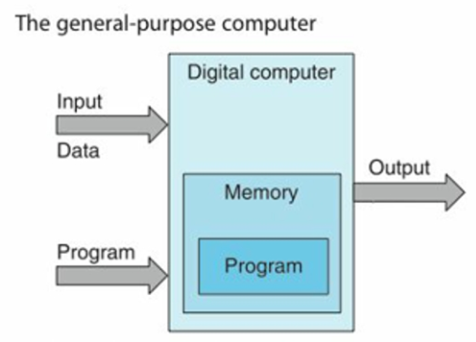
OVERVIEW
General-purpose computer
  an electronic and digital computing machine that follows a step-by-step list of instructions called algorithm or program to solve a problem.
  also called von Neumann machine
Notes:
Johann von Neumann, who was one of the first to quantify the structure of a computer.

Slide 4
WHY STUDY COMPUTER ORGANIZATION &ARCHITECTURE?
Design better programs especially system software such as compilers, operating systems, and device drivers.
Optimize program behavior.
Evaluate (benchmark) computer system performance.
Understand time, space, and price tradeoffs.
Notes:
Optimize program behavior – you will know how you are going to write the program to fit limited memory space,
Evaluate (benchmark) computer system performance – you know what aspects of the computer system you are going to look at to know which one is better. You will be able to tell if one computer system is good in one aspect but not good in another aspect as compared to another computer.
Understand time, space, and price tradeoffs.- Time here refers to the processor speed, space is the memory space. This is particularly important when deciding to buy a computer. Will you choose high powered CPU over large memory or vise versa? Intel Core i9 or AMD Ryzen

Slide 5
COMPUTER SYSTEM ORGANIZATION
refers to the operational units and their interconnection that realize the architecture specification.
consists of physical units like circuit designs, peripherals and adders
it deals with the low-level design issue
describes how a computer works
Examples of organization attributes include those hardware details transparent to the programmer, such as control signals, interfaces between the computer and peripherals, and the memory technology used.

Slide 6
THE COMPUTER SYSTEM ARCHITECTURE
refers to those attributes of a system visible to a programmer or those attributes that have a direct impact on the logical execution of a program.
comprises logical functions such as instruction sets, registers, data types and addressing modes.
describes what the computer does.
Examples of architecture attributes include the instruction set, the number of bit to represent various data types (e.g.., numbers, and characters), I/O mechanisms, and technique for addressing memory.
Notes:
In describing computer system, a distinction is often made between computer architecture and computer organization.
As an example, it is an architectural design issue whether a computer will have a multiply instruction.
It is an organizational issue whether that instruction will be implemented by a special multiply unit or by a mechanism that makes repeated use of the add unit of the system. The organization decision may be bases on the anticipated frequency of use of the multiply instruction, the relative speed of the two approaches, and the cost and physical size of a special multiply unit.

Slide 7
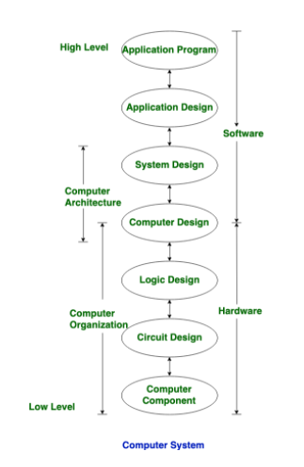
THE COMPUTER SYSTEM

Slide 8
COMPUTER ORGANIZATION & ARCHITECTURE
Historically, and still today, the distinction between architecture and organization has been an important one.
Many computer manufacturers offer a family of computer model, all with the same architecture but with differences in organization. Consequently, the different models in the family have different price and performance characteristics.
An architecture may survive many years, but its organization changes with changing technology.

Slide 9
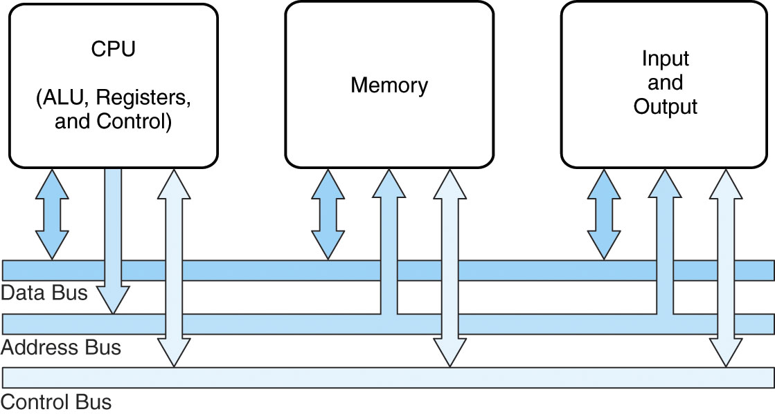
COMPUTER SYSTEM COMPONENTS
Notes:
At the most basic level, a computer is a device consisting of 3 pieces
A processor to interpret and execute programs
A memory ( Includes Cache, RAM, ROM)
to store both data and program instructions
A mechanism for transferring data to and from the outside world.
I/O to communicate between computer and the world
Bus to move info from one computer component to another

Slide 10
COMPUTER SYSTEM COMPONENTS
CPU (Central Processing Unit)
  Brain of the computer
  Interprets and executes programs
  Parts:
    ALU (Arithmetic Logic Unit) – performs arithmetic computations and logical operations.
    Registers – temporary storage inside the CPU that hold the data and information of a currently executing instruction.
    Control Unit – interprets the instruction for the CPU.

Slide 11
COMPUTER SYSTEM COMPONENTS
Memory
  physical device capable of storing information temporarily or permanently.
  The one that the CPU has direct access to
  Types:
    ROM (Read-Only Memory)
      storage of non-volatile data
      small in size
      contains the boot firmware
    RAM(Random Access Memory)
      storage of volatile data
      where user programs are loaded for execution

Slide 12
COMPUTER SYSTEM COMPONENTS
Memory (RAM) Segments
  Code Segment – where program codes are loaded
  Data Segment – where global variables are loaded
  Stack Segment – where local variables are loaded
  Extra Segment – where objects and other data are loaded
I/O Subsystem
  Consists of ports where I/O devices/peripherals are connected
  Uses controllers
System Bus
  Data Bus
  Address Bus
  Control Bus

Slide 13
VON NEUMANN
FETCH-EXECUTE CYCLE
The von Neumann architecture operates on the fetch-execute cycle
  Fetch an instruction from memory as indicated by the Program Counter register
  Decode the instruction in the control unit
  Data operands needed for the instruction are fetched from memory
  Execute the instruction in the ALU storing the result in a register
  Move the result back to memory if needed

Slide 14
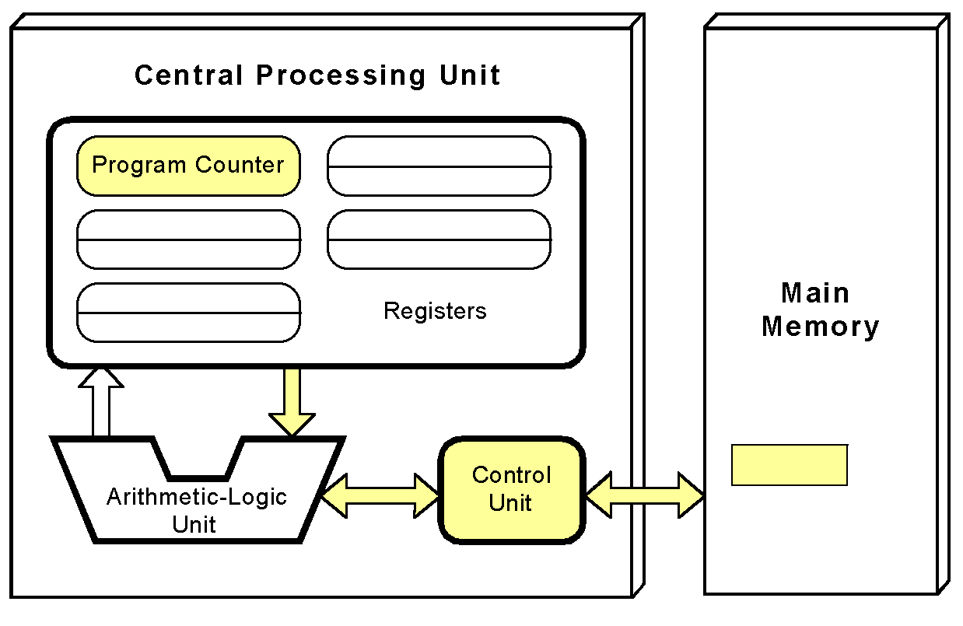
VON NEUMANN
FETCH-EXECUTE CYCLE
The control unit fetches the next instruction from memory using the program counter to determine where the instruction is located

Slide 15
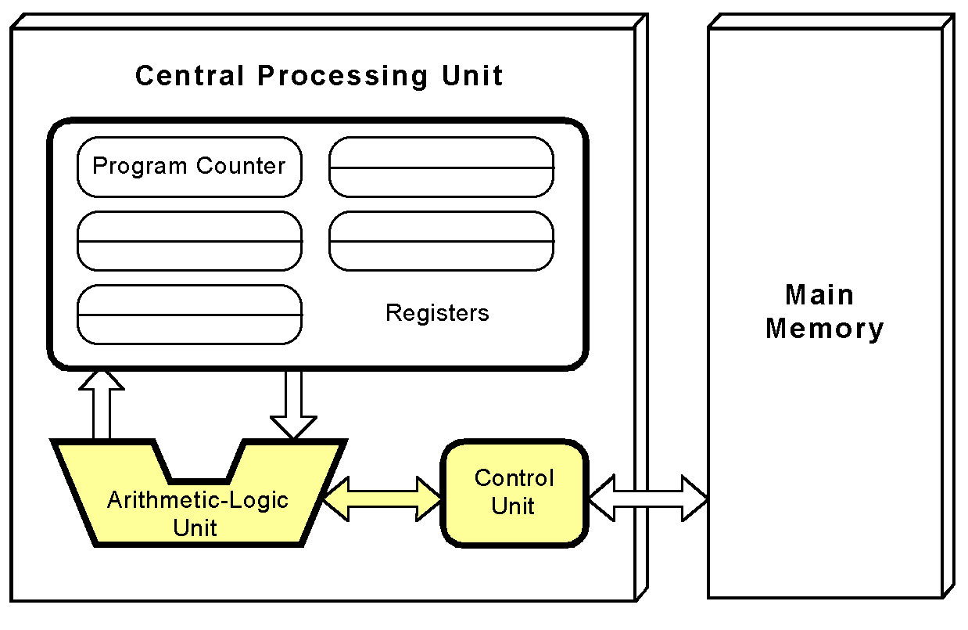
VON NEUMANN
FETCH-EXECUTE CYCLE
The instruction is decoded into a language that the ALU can understand.

Slide 16
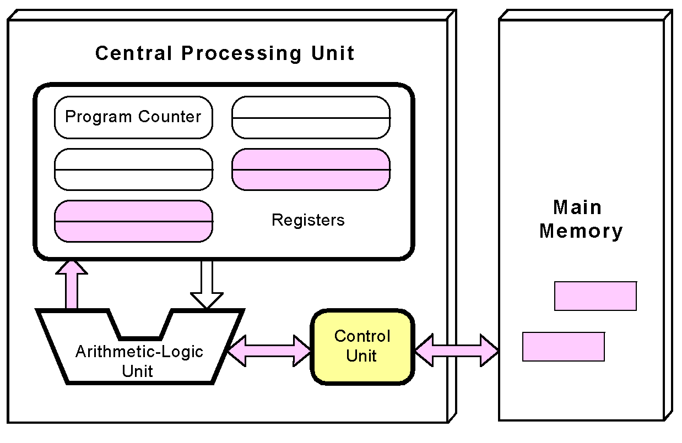
VON NEUMANN
FETCH-EXECUTE CYCLE
Any data operands required to execute the instruction are fetched from memory and placed into registers within the CPU.

Slide 17
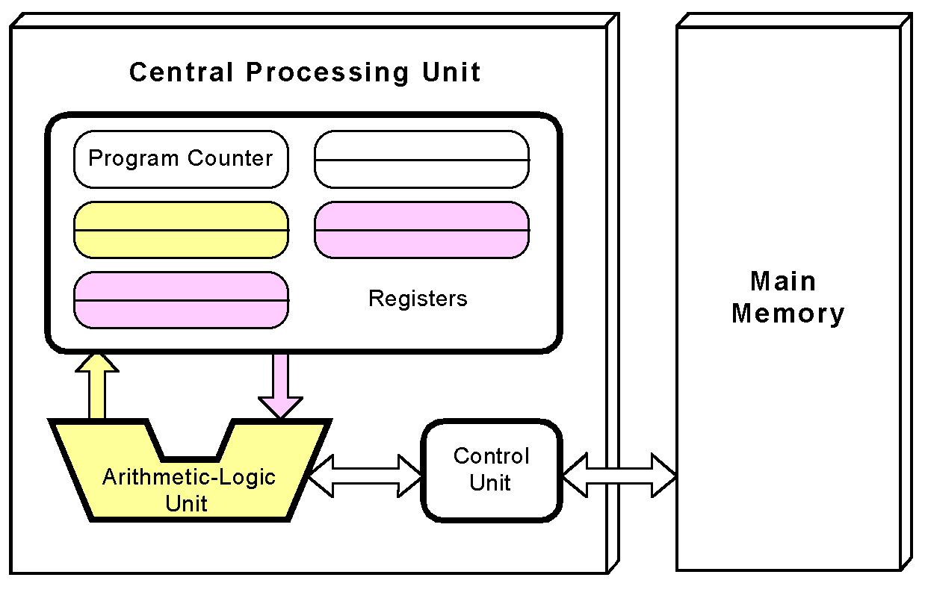
VON NEUMANN
FETCH-EXECUTE CYCLE
The ALU executes the instruction and places results in registers or memory.

Slide 18
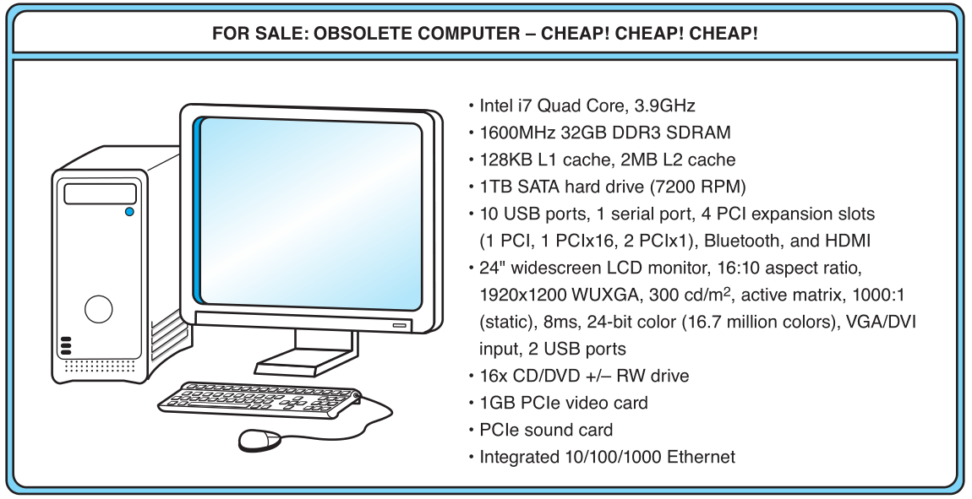
A COMPUTER SYSTEM EXAMPLE
What does it all mean?

Slide 19
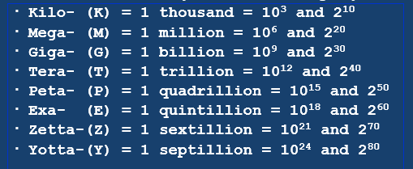
MEASURES OF CAPACITY & SPEED
Hertz = clock cycles per second (frequency)
  1MHz = 1,000,000Hz
  Processor speeds are measured in MHz or GHz.
Byte = a unit of storage
  1KB = 2¹⁰ = 1024 Bytes
  1MB = 2²⁰ = 1,048,576 Bytes
  Main memory (RAM) is measured in MB
  Disk storage is measured in GB for small systems, TB for large systems.

Slide 20
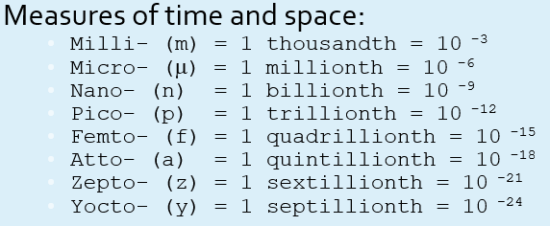
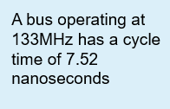
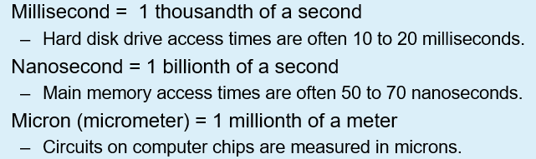
MEASURES OF CAPACITY & SPEED

Slide 21
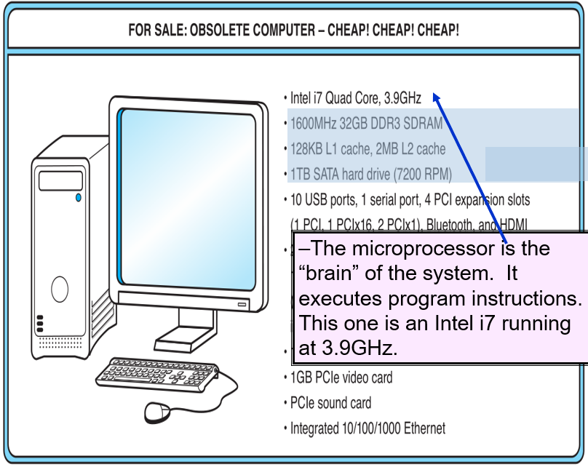

Slide 22
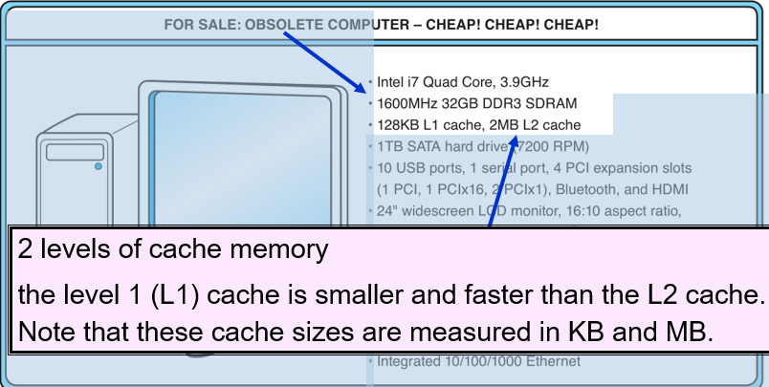
This system has 32GB of (fast) synchronous dynamic RAM (SDRAM)
Notes:
SDRAM (Synchronous Dynamic Random Access Memory):
DDR SDRAM (Double Data Rate SDRAM):

Slide 23
1.3 AN EXAMPLE SYSTEM
Hard disk capacity determines the amount of data and size of programs you can store.
This one can store 1TB. 7200 RPM is the rotational speed of the disk. Generally, the faster a disk rotates, the faster it can deliver data to RAM.

Slide 24
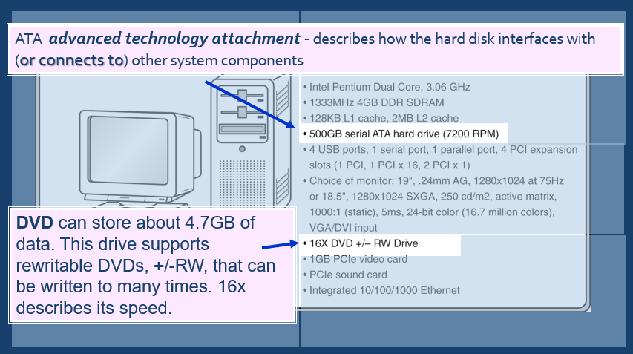

Slide 25
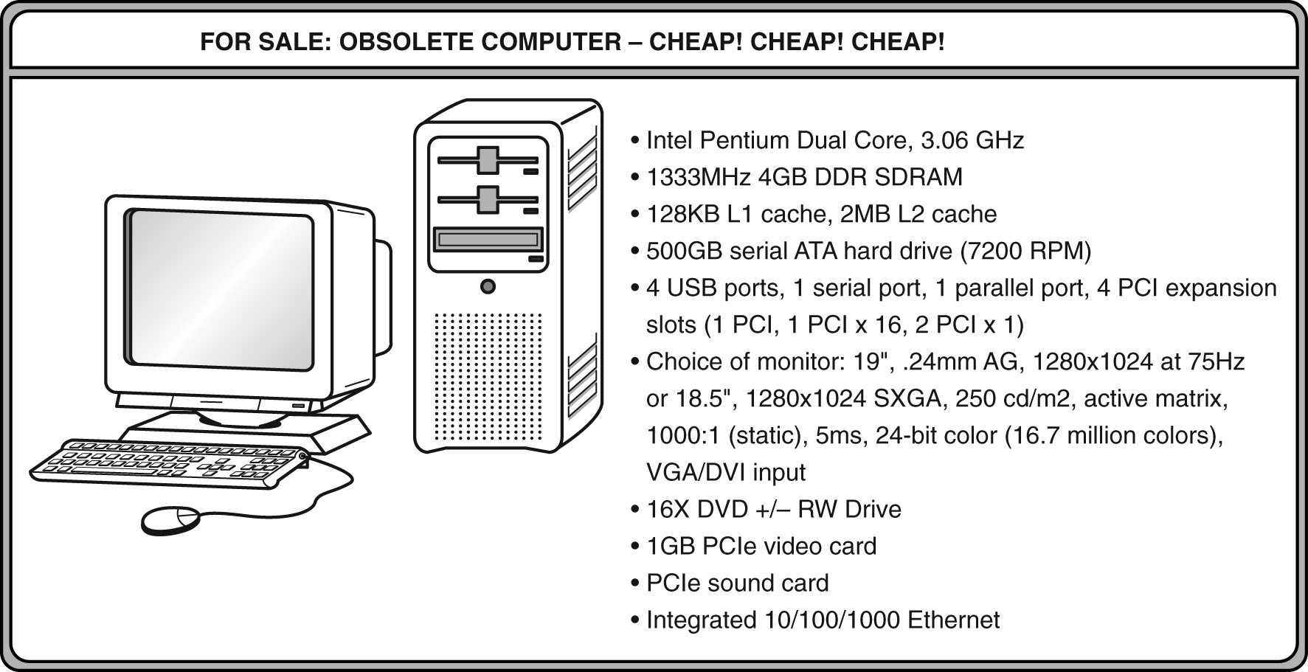
Ports allow movement of data between a system and its external devices.
This system has ten ports.

Slide 26
PORTS
Serial ports send data as a series of pulses along one or two data lines.
Parallel ports send data as a single pulse along at least eight data lines.
USB, Universal Serial Bus, is an intelligent serial interface that is self-configuring. (It supports “plug and play.”)

Slide 27
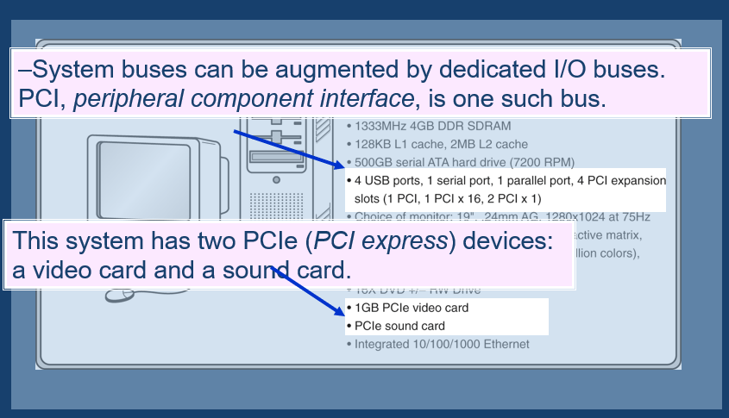

Slide 28
Active matrix technology uses one transistor per picture element (pixel). The resolution of a monitor determines the amount of text and graphics that the monitor can display.
Super VGA (SVGA) tells us this monitor has a resolution of 1280 × 1024 pixels.
The video card contains memory and programs that support the monitor.

